Slide 1



Comparative Analysis of Deep Learning Architectures (LSTM, CNN, and Transformers)
for NEPSE Stock Price Prediction
f'islington college
(;it�c1$_Col cf>ffi51)
Student Name: Amiks Karki London Met ID: 23049352
College ID: NP01CP4A230172
Module: CU6051NI Artificial Intelligence Submission Date: January 21, 2026
Unlocking market patterns in emerging economies through advanced sequence modeling.

Slide 2
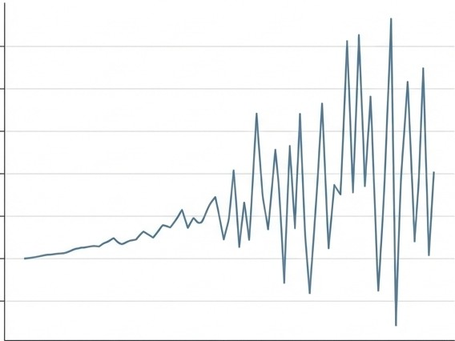
The Challenge of Emerging Markets: Why NEPSE?
Market Volatility
The Domain: NEPSE(Nepal Stock Exchange) is driven by political events and investor
psychology, creating high noise and non-linearity.
The Problem:Traditional statistical models (ARIMA/Linear) fail to capture these complex dependencies.
The Knowledge Gap: Limited research exists applying Deep Learning to Nepal's specific market dynamics compared to global markets.
Research Goal: A rigorous comparison of Recurrent (LSTM), Convolutional (CNN), and Attention-based (Transformer) architectures.
NEPSEMarket Characteristics: Non-linear & High Volatility.

Slide 3
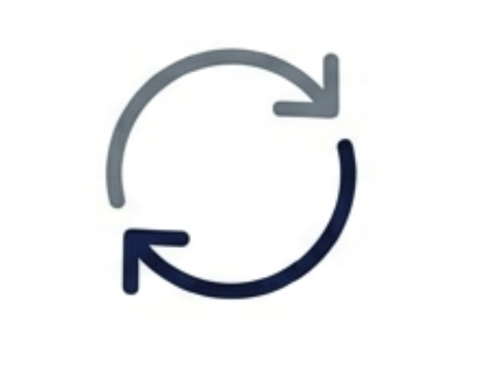


The Protagonists: Three Architectures
LSTM
The Memory Expert
CNN (1D)
The Pattern Hunter
Transformer
The Attention Mechanism
Long Short-Term
Memory
Specialized for temporal dependencies and overcoming vanishing gradients
1D Convolutional
Neural Network
Adapted from image processing to extract local short-term trends efficiently.
Self-Attention Models
Weighs the importance of different time steps in parallel.

Slide 4
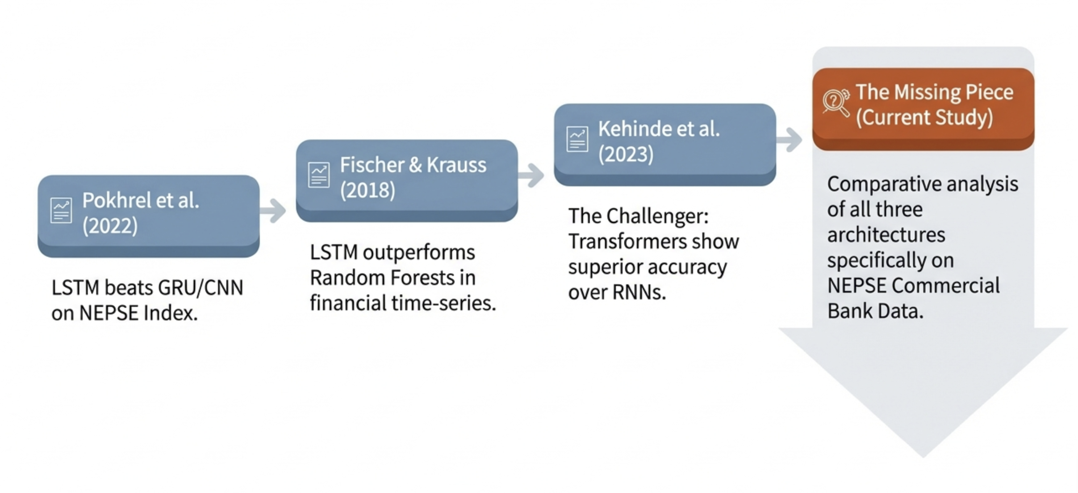
Research Evidences in Financial Forecasting

Slide 5
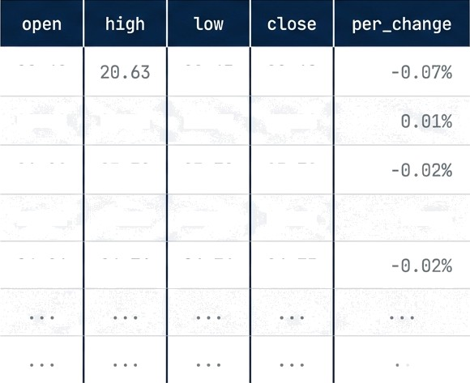
17
Commercial Banks (NABIL, NICA, SCB, etc.)
Data Acquisition & Preparation
53, 063
Total Trading Records (2009-2025)
20 . 4 0
20 . 63
20. 08
20 . 80 21. 57 21. 57 21. 58
60 Days
Sliding Window Sequence Length
Features
Close Price + Momentum
+ Company Embeddings
23 . 12 25. 01 25 .01 25 .09
0. 01%
80 20
Temporal Split (Train / Test)
26 . 20
24. 76
26 . 70
26 . 75

Slide 6
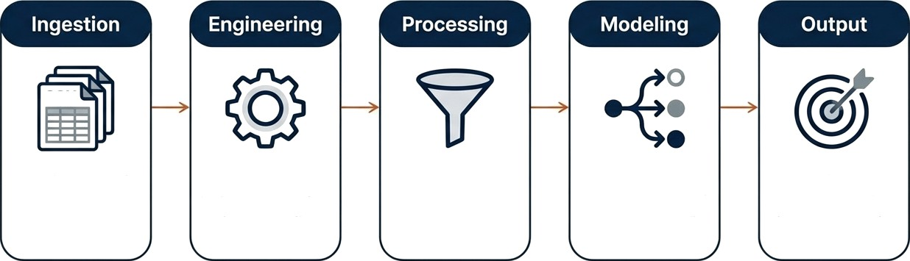
End-to-End System Architecture
CSV
Load 17 Bank
Datasets.
Feature Eng.
Temporal Split
6 Scaling
Embeddings + [LSTM / CNN / Transformer]
Next-Day Closing Price (Regression)
& Sequence Gen(60 Days)

Slide 7
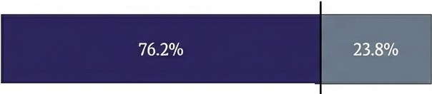
Implementation & Training Configuration
Configuration Specs Temporal Split Strategy
Objective: Regression
Loss: MSE
Optimizer:Adam (LR=0.001)
Scheduler: ReduceLROnPlateau
Safety: Early Stopping (Patience=15)
Sept2022
Training Set
(Pre-Sept 2022)
39,632 sequences
Test Set (Post-Sept 2022) 12,411sequences
Strict temporal splitting prevents look-ahead bias and simulates real-world forecasting.
Hardware: NVIDIA Tesla T4 CPU (Google Colab).

Slide 8
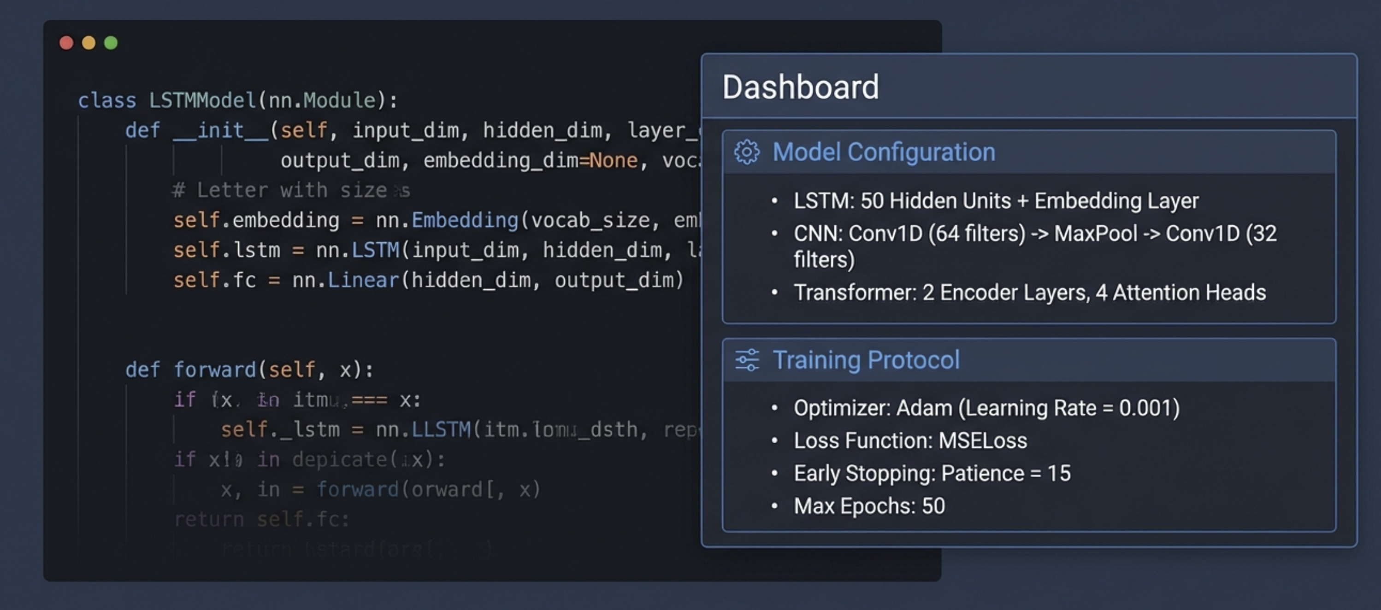
Model Architectures & Logic

Slide 9
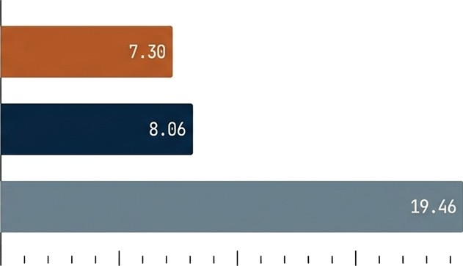
Performance Comparison Results
Model RMSE (Lower is Better)
LSTM Statistics:
LSTM
RMSE:
R2:
MAPE:
7.30
0.9978
1. 31%
CNN
Conclusion: LSTM provides the lowest error and highest stability.
Transformer
I 20
10
zs

Slide 10
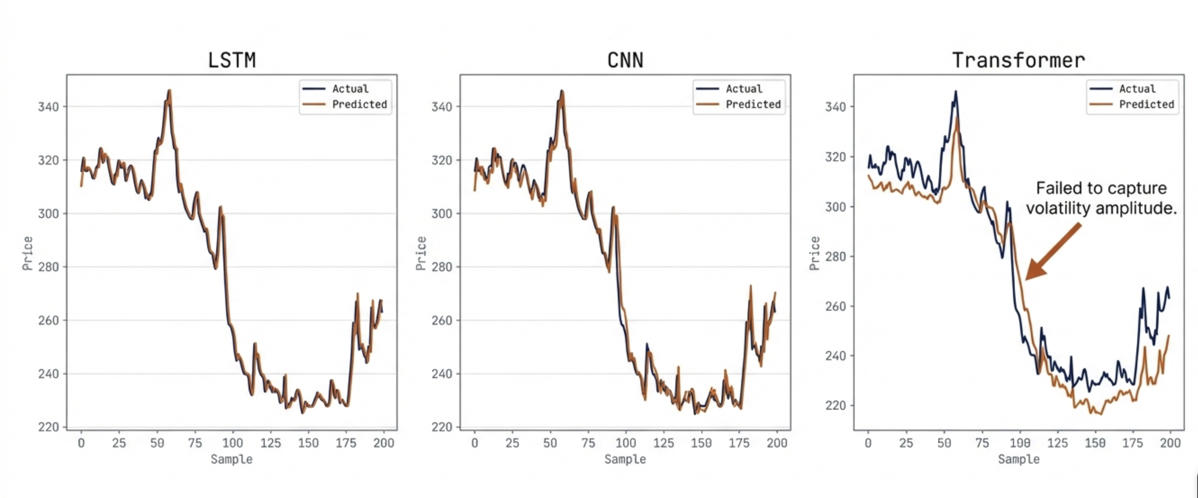

Visualizing Predictions vs. Reality

Slide 11
Critical Analysis of Findings
Why LSTM Won Why Transformer Underperformed
Recurrent Architecture: The LSTM’s memory cells were perfectly suited for the 60-day temporal dependencies of daily stock data.
Sequence Length: 60 days is likely too short for 'Self- Attention ' mechanisms to thrive.
Data Volume: Transformers generally, require massive datasets to generalize better than RNNs.
Feature Engineering Insight: Minimal features (Price + Momentum + Embeddings) reduced noise compared to complex technical indicators.

Slide 12




Key Findings & Impact
Sequence Matters
LSTM's memory architecture is currently superior for this specific data scale.
Unified Modeling
Embeddings successfully allowed one
model to predict for 17 banks.
Simplicity Wins
Removing complex technical indicators improved regression accuracy.
Transformer Limitations
Attention mechanisms need longer sequences to outperform recurrence.

Slide 13




Real-World Applications
Investors & Traders
Data-driven decisions
Financial Institutions Automated risk assessment and portfolio management.
Regulators (SEBON)
Anomaly detection for market manipulation monitoring.
Market Transparency
Reducing information asymmetry in
the Nepali economy.

Slide 14
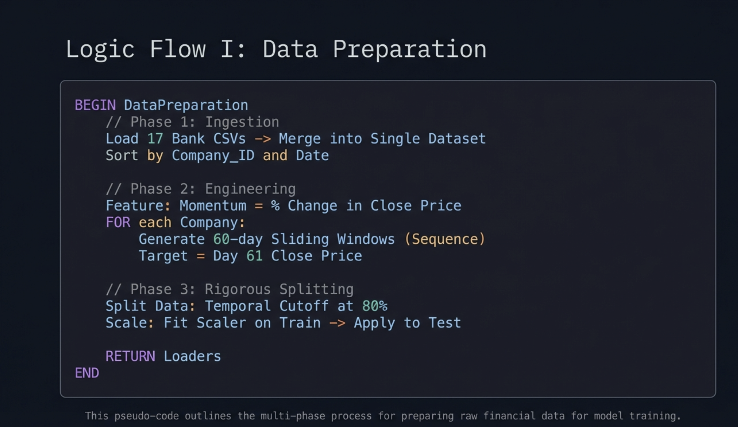

Slide 15
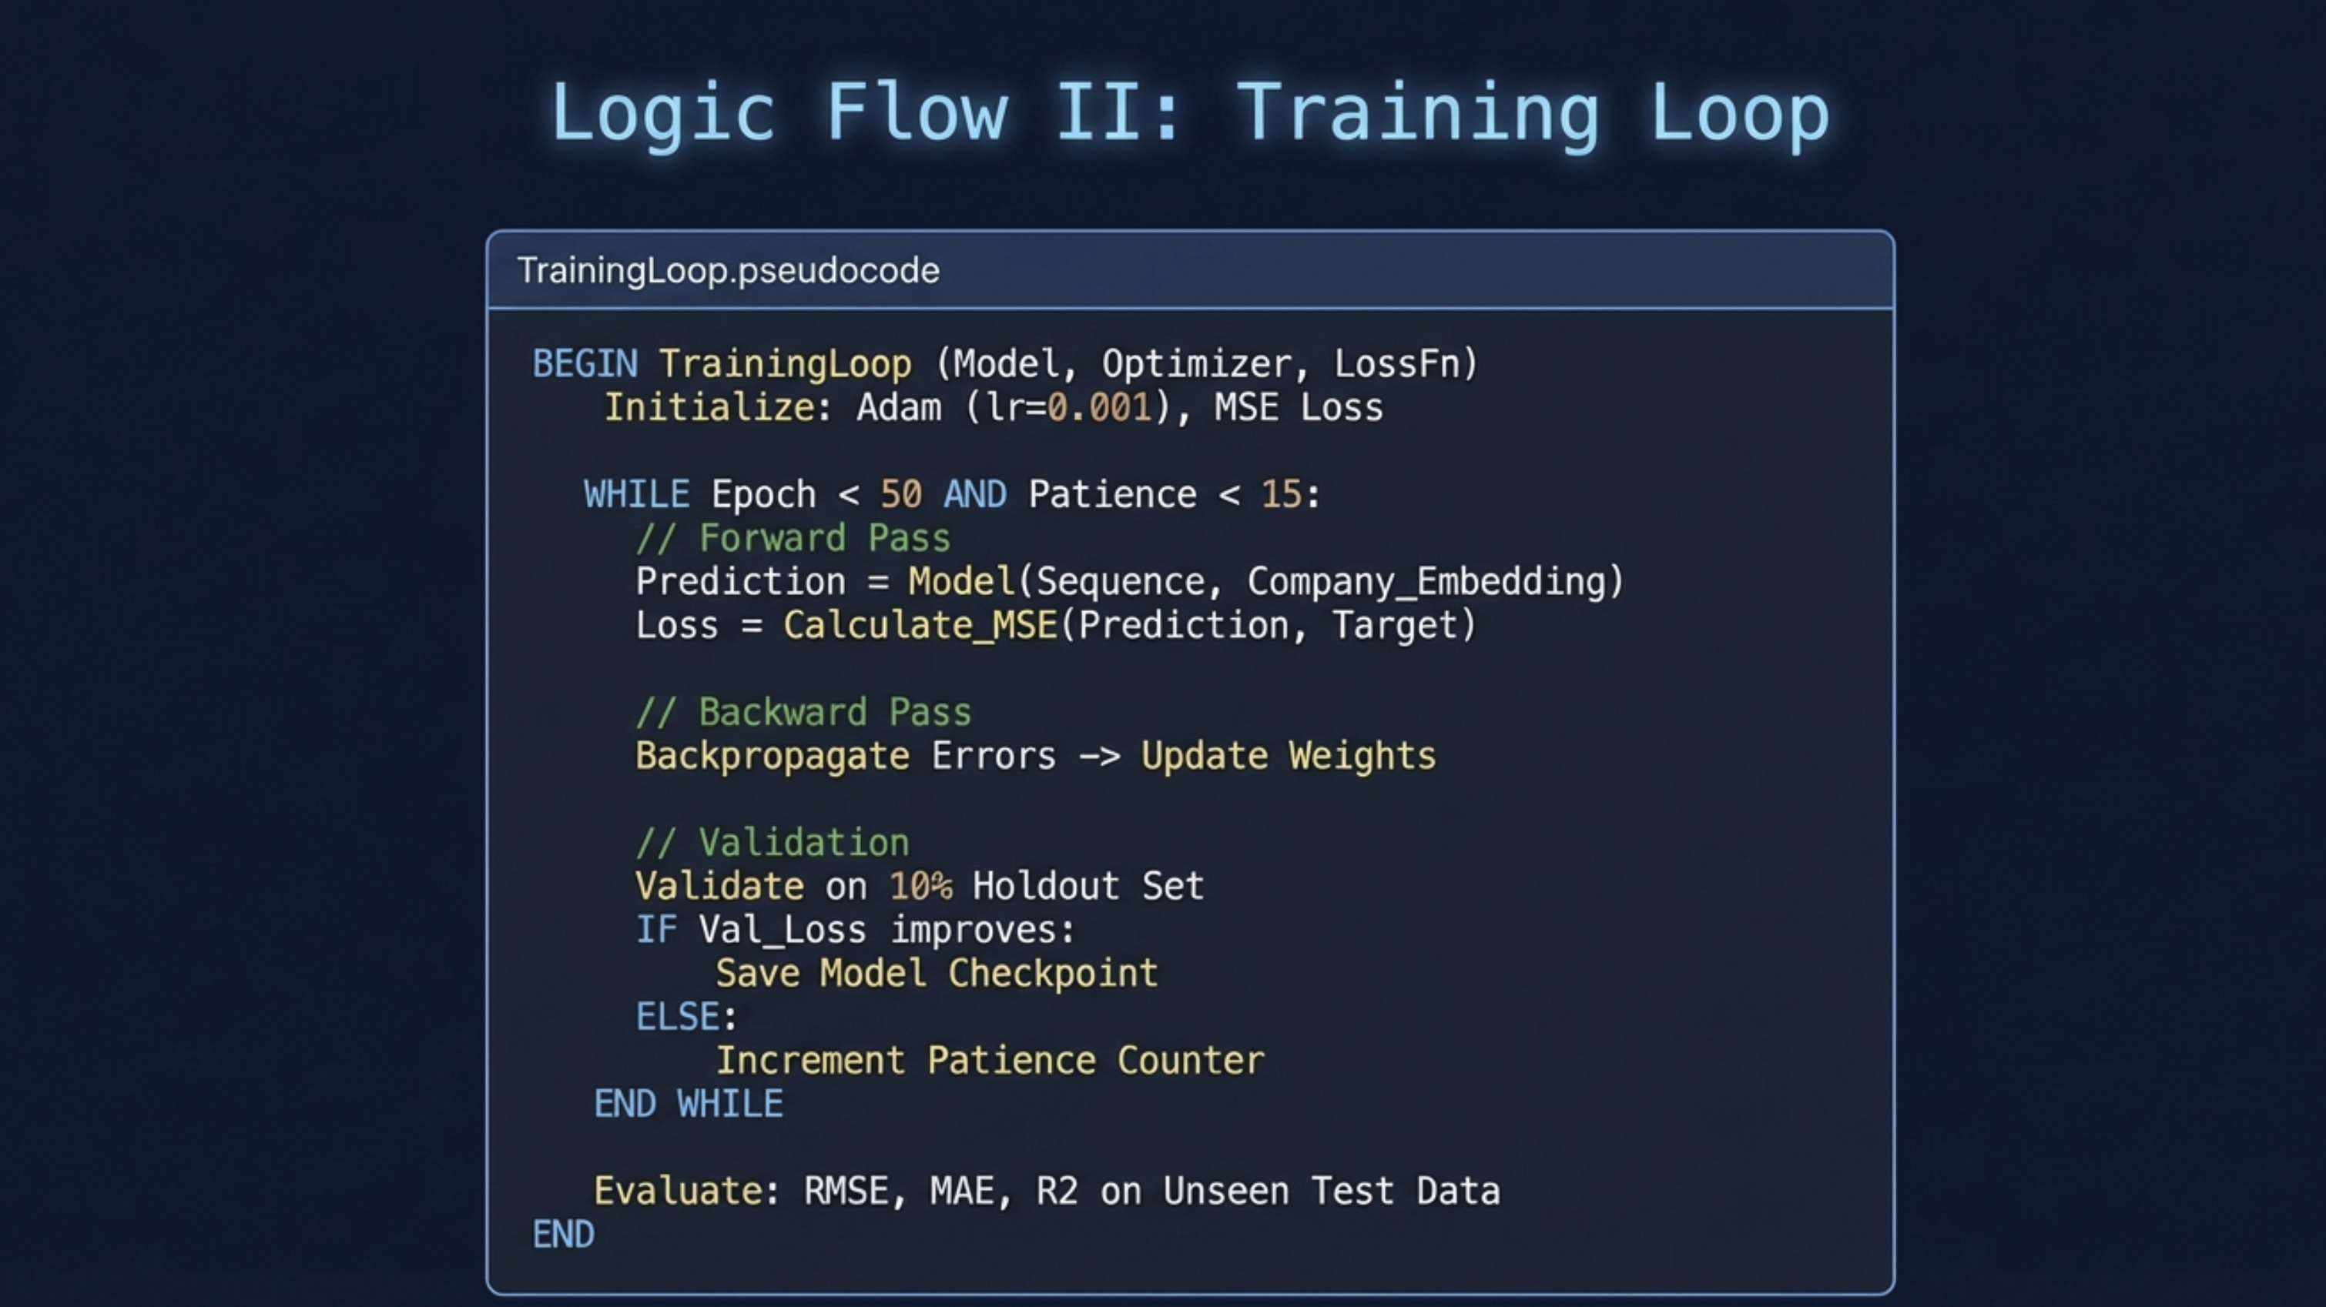

Slide 16
Conclusion & Future Directions
LSTM is the valid architecture for daily NEPSE prediction.
Future Roadmap
Extended Horizon
Weekly/Monthly forecasting.
Hybrid Models
Ensemble LSTM + CNN.
Extend Data
Integrate data such as News Sentiment, Sector Index
Deployment
Real-time trading API.

